Slide 1
Architecture Of Workspace Reservation System

Slide 2
Introduction
In this project, we have tried to create an architecture for a workspace reservation system. In the following few slides, we will describe the architecture in a progressively more implementation-oriented fashion. First, we will discuss about the use case of the system using a use case diagram to understand the requirements. Then, we will see the activity diagram to understand the process. Then, to understand the logic and data relationship, we will look at the data flow diagram, ER diagram, and class diagram.
Then, we will examine how all these connects to create the system using sequence diagram, and finally, we will learn about how to deploy the application for scaling and high availability.

Slide 3
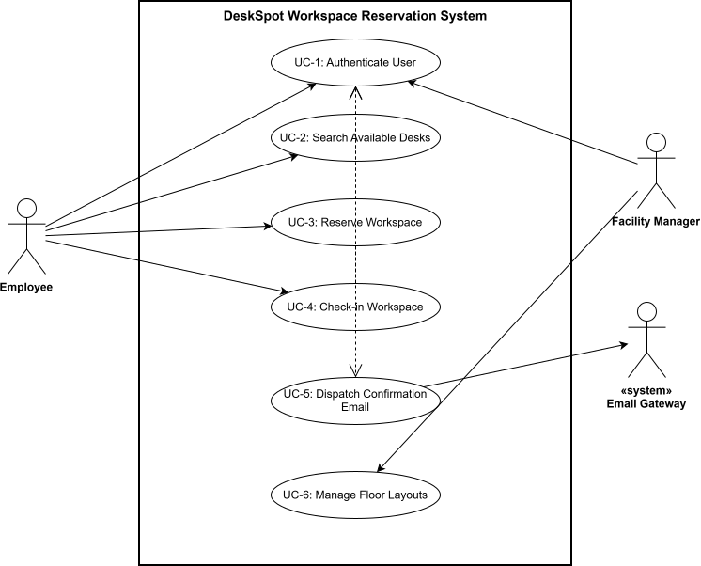
Use Case Diagram
The Use Case Diagram defines the functional scope and user interactions of DeskSpot across two main actors: the Employee and the Facility Manager. The Employee interacts with the system to authenticate, filter and search available workspaces by date and time shift, reserve a specific desk, and check in on-site using a generated digital QR pass. Concurrently, the Facility Manager utilizes the administrative capabilities to monitor floor capacity and track real-time space utilization across the organization.
The Email Gateway is a third party system to send notification.

Slide 4
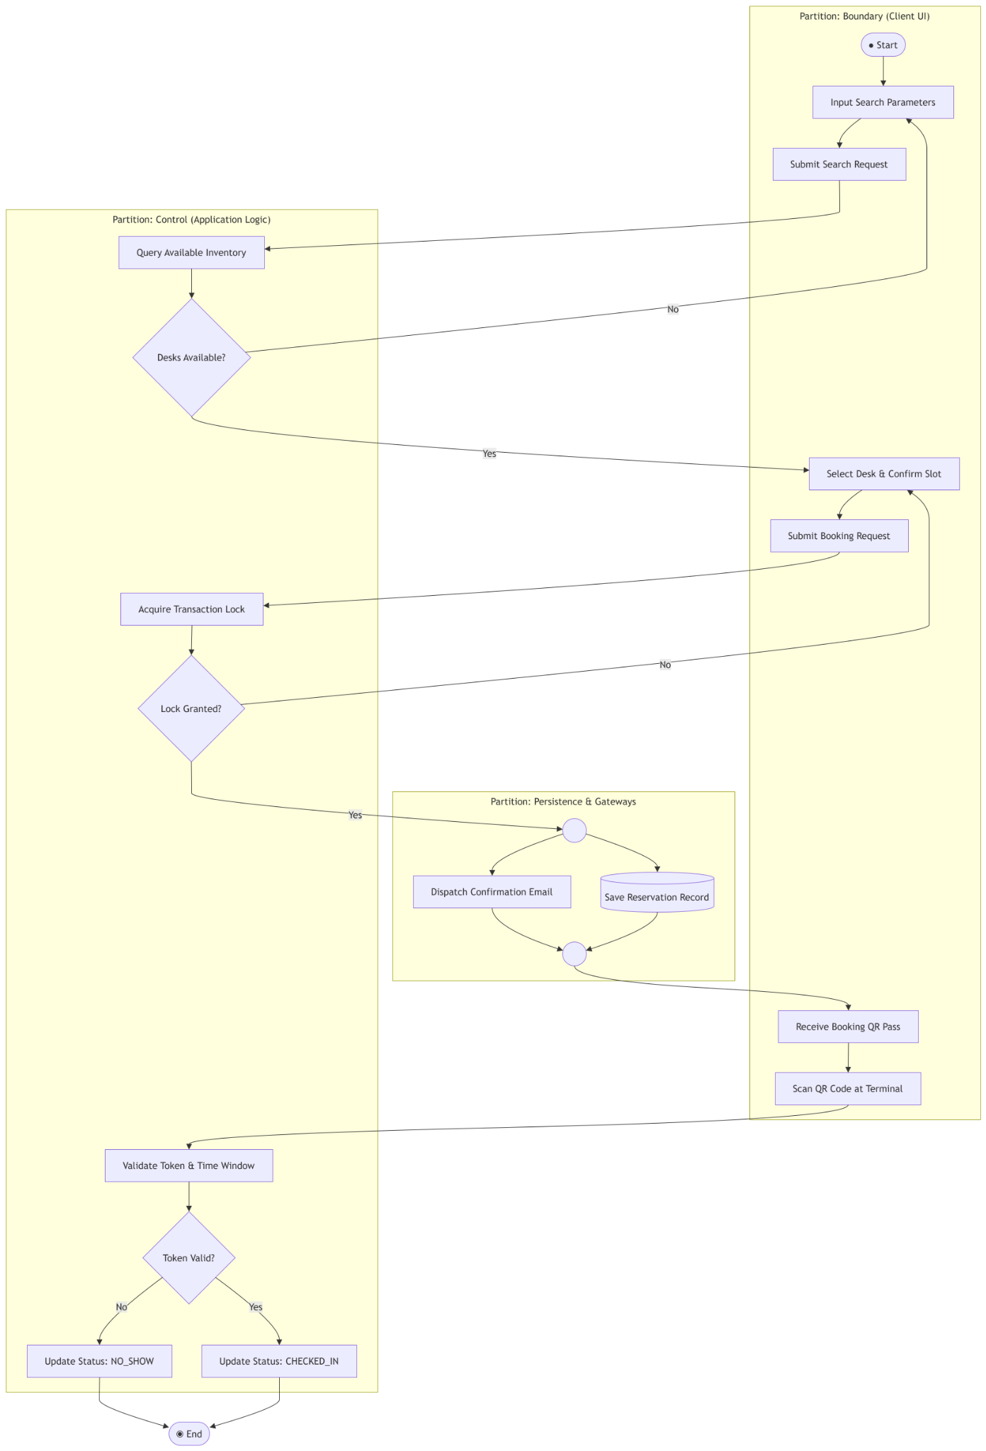
Activity Diagram
The Activity Diagram models the step-by-step operational workflow and decision logic of the desk reservation process. It captures the flow from the moment an employee selects a target desk and time slot, through the backend validation checks—such as executing time-slot availability checks—to the final branching logic. If a scheduling conflict or lock failure occurs, the workflow routes to an error handling path; otherwise, it proceeds through transaction commit, booking confirmation, and QR pass generation, ending with the user's physical check-in at the terminal.

Slide 5
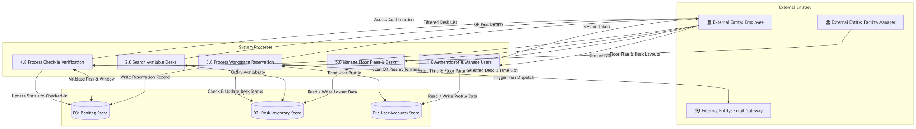
Data Flow Diagram
The Data Flow Diagram (DFD) maps the movement of data through DeskSpot, illustrating how information transitions between external entities, system processes, and persistent data stores. It tracks input data—such as user credentials, search parameters, and reservation requests—as it flows from the client interface into core processing nodes like the Auth Manager, Availability Engine, and Booking Processor. These processes transform the inputs, interact with backend data stores (Users, Desks, Bookings), and emit structured output data, including real-time availability matrices, transaction confirmation statuses, and signed QR access passes back to the user.

Slide 6
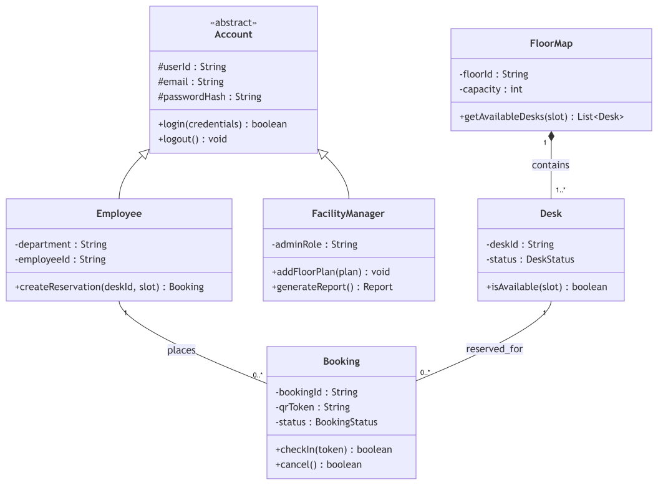
Class Diagram
The Class Diagram captures the core business concepts, entities, and structural relationships of the DeskSpot system independently of software implementation details. It defines real-world domain entities like User, Desk, Floor, Booking, and CheckIn, establishing their attributes, business rules, and relative cardinalities—such as an Employee holding multiple Bookings, or a Floor containing multiple Desks. By mapping these domain concepts early on, it establishes a shared domain language and lays the foundation for transforming business requirements into the downstream relational database schema

Slide 7
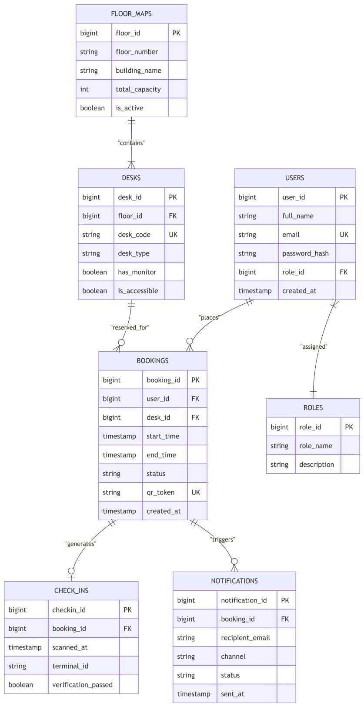
ER Diagram (Crowbar Notion)
The Entity-Relationship Diagram (ERD) translates the high-level domain model into a concrete, relational database schema hosted on PostgreSQL. It explicitly defines table structures, data types, primary and foreign key constraints, and relational cardinalities between core entities like USERS, DESKS, BOOKINGS, and CHECK_INS. Crucially, the schema enforces integrity constraints at the data layer—such as cascade rules, unique indexes, and time-range bounds—ensuring that business rules are strictly maintained at the relational level before application logic even interacts with the stored records.

Slide 8
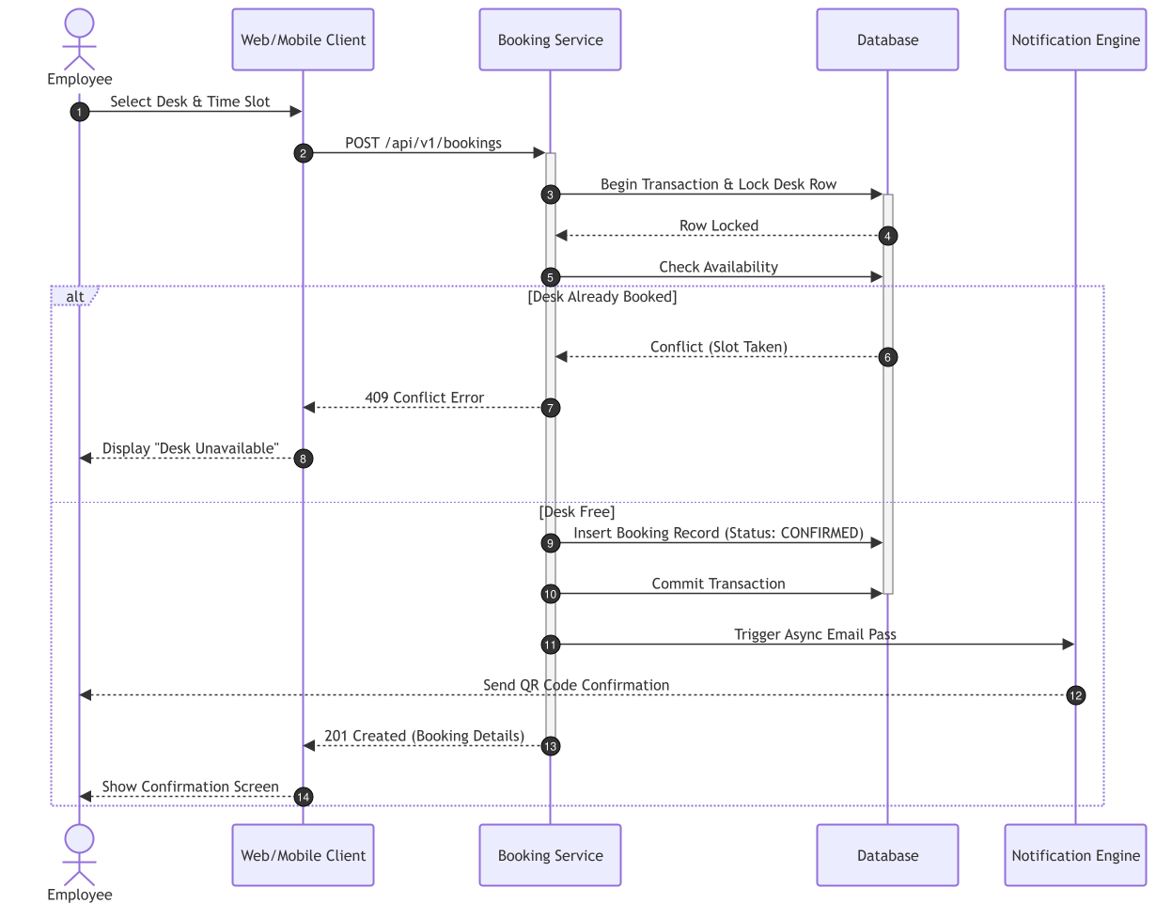
Sequence Diagram

Slide 9
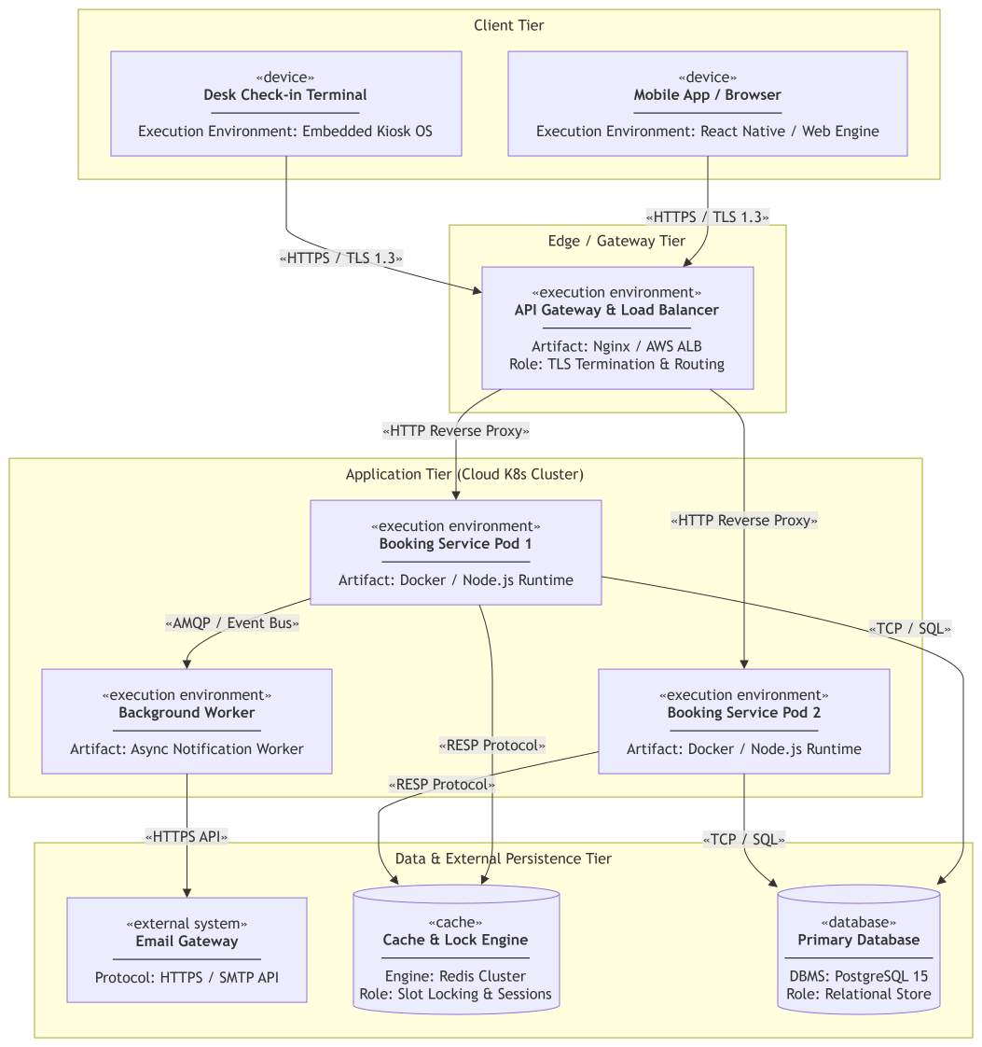
Deployment Diagram
The deployment diagram describes an idealized implementation and deployment of the system.

Slide 10
Conclusion

